Slide 1
Web Development Final
By Daven Heng 240463A

Slide 2
What is my website about
First person shooter Valorant created by the developer Riot Games.
The target audience is people who wants to join Valorant or players in Valorant

Slide 3


Navigation bar
Rank
Current page (homepage)
Agents
Form submit goes to submitted page

Slide 4
What to run first
Run homepage.html first
Input iron 1 for rank page
Input jett for agent page
For error validation input sigma to see the error (will repeat so input the top 2 to see the page)
For form input daven in name and Davening#huh in the riot id choose any rank for rank

Slide 5
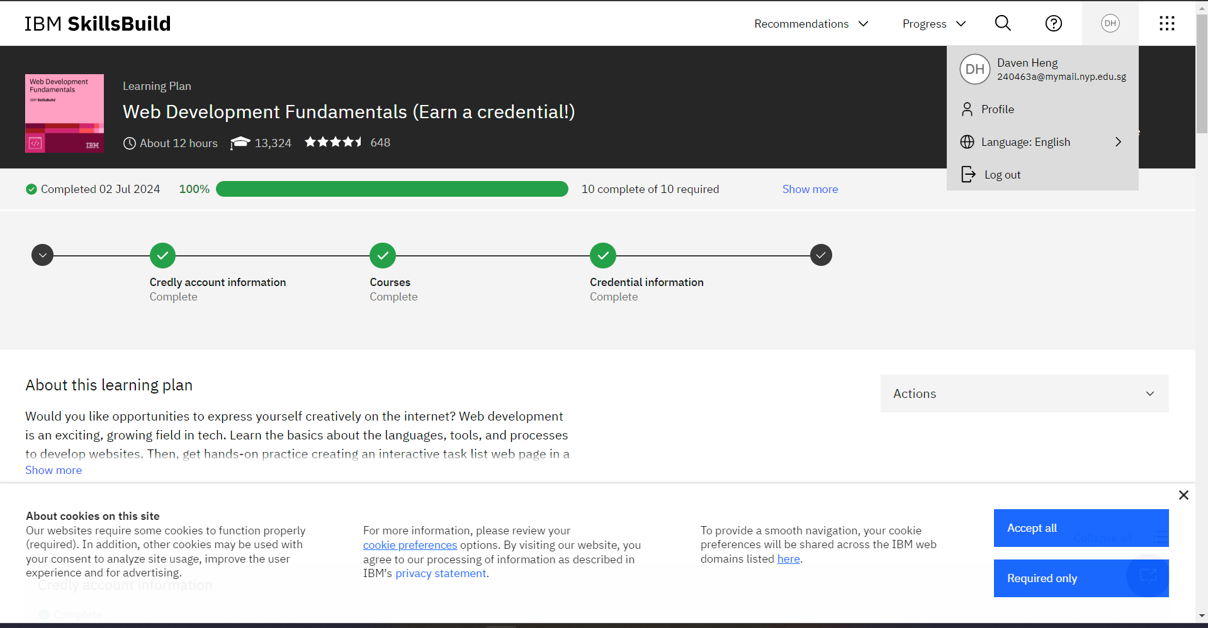
IBM Skillsbuild 100%

